Slide 1


WE Chatbot – RAG-based Intelligent Assistant
Proof of Concept for Telecom Egypt Customer Support
Presenter: Mostafa Mohamed Qapil – AI Engineer | Data Scientist

Slide 2


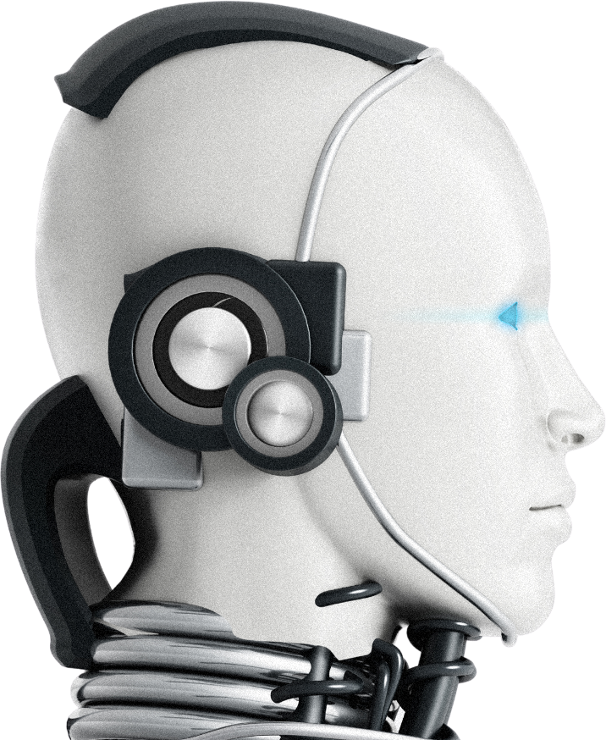
Project Objective
02
Build an intelligent assistant for Telecom Egypt (WE) customers.
Support English & Arabic, including Egyptian dialect.
Retrieve info from official website + uploaded documents.
Showcase practical RAG pipeline implementation.

Slide 3


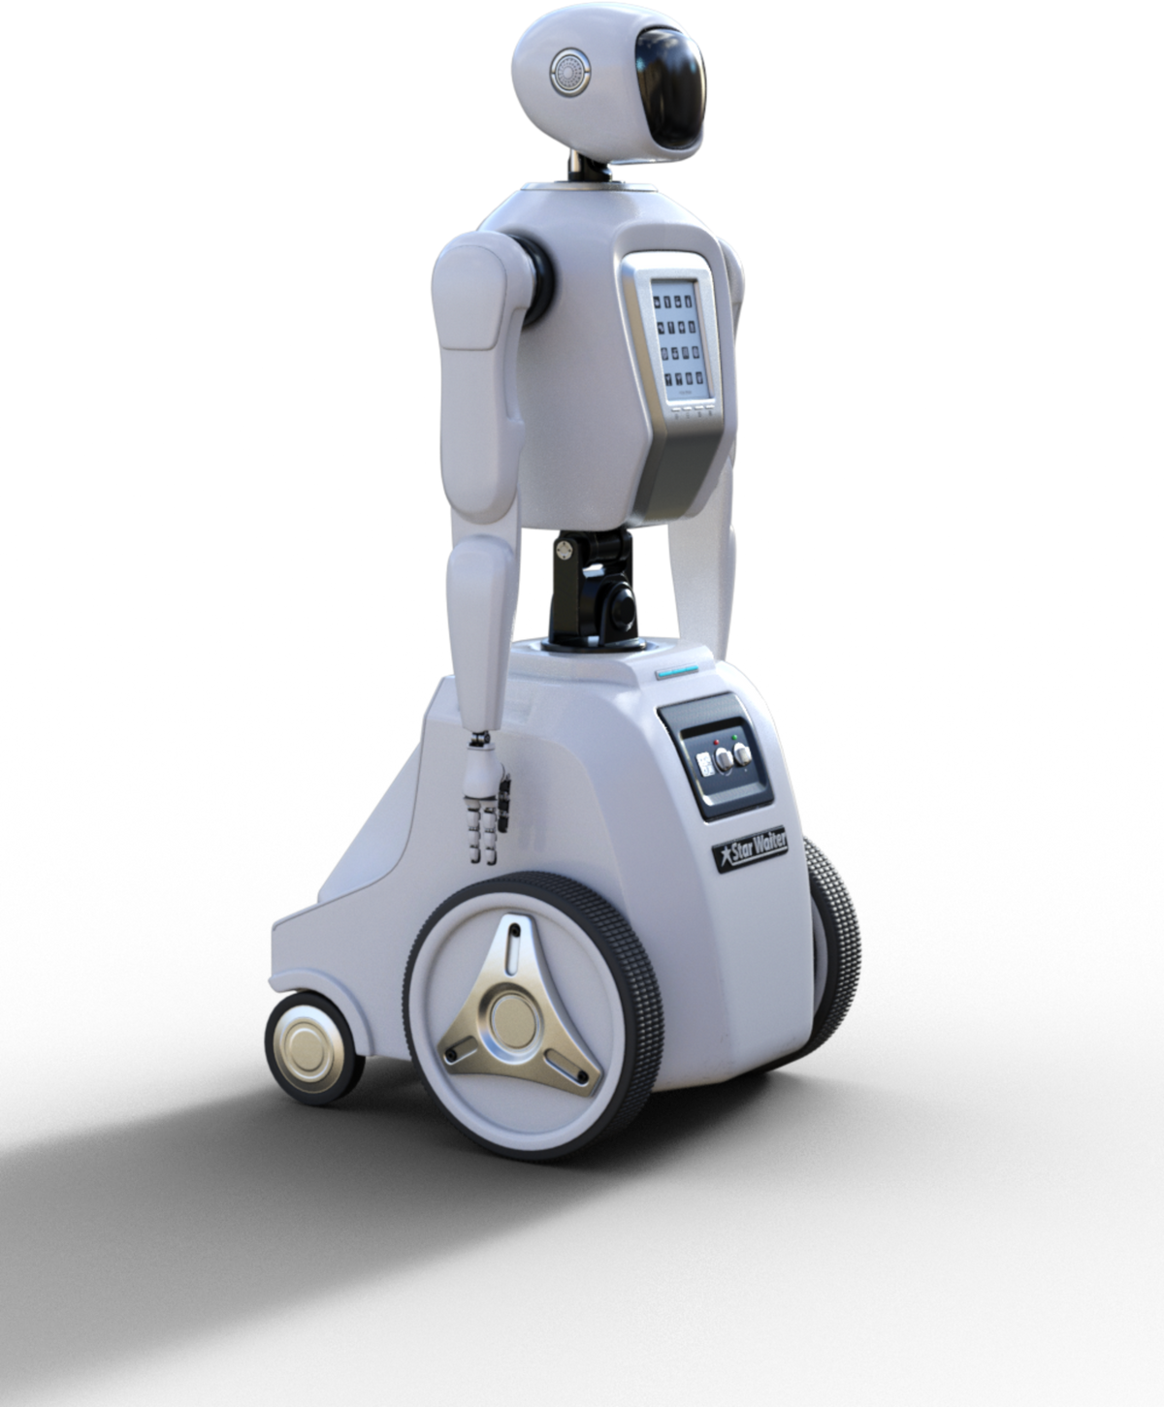
Challenges Encountered
Hardware Limitations: Could not deploy large LLMs.
Web Scraping: Dynamic JS pages required Selenium & headless Chrome.
File Diversity: PDF, DOCX, TXT, HTML, images with OCR.
Vector Indexing Issues: FAISS path & index loading problems.
Deployment Constraints: Streamlit local deployment used.
03

Slide 4
Technical Approach & Workflow
04
Data Extraction: Scraped official WE site & cleaned text.
Text Processing: Chunking + normalization for embeddings.
Embedding & Indexing: Sentence Transformers + FAISS vector store.
Query Handling & RAG: Top-K chunk retrieval + mt5-base LLM.
User Interaction: Streamlit chat with upload support.

Slide 5


Implementation Highlights
05
Dynamic Document Addition: Add user docs to FAISS on-the-fly.
Multilingual Support: Arabic & English handled.
Citation Awareness: Each answer shows sources.
Quick Question Buttons: Common queries for faster demo.
OCR Support: Reads text from uploaded images.

Slide 6



Problems Solved & Optimizations
06
Optimized chunk size for memory & relevance.
Keyword filtering to reduce irrelevant results.
FAISS normalization fixed similarity scoring.
Custom Streamlit UI: chat bubbles, landing page.
Error Handling: Missing index, unsupported files, empty responses.

Slide 7



Lessons Learned & Future Improvements
07
Lessons Learned:
RAG pipeline implementation in practice.
Hardware & software constraints handling.
Multilingual document processing & indexing.
Future Improvements:
Fine-tune Arabic LLM for dialect-specific answers.
Deploy on GPU server for faster inference.
Feedback-based ranking for answer accuracy.
Session memory for contextual conversations.

Slide 8


Project Links & Demo
GitHub: https://github.com/mostafaqapil/WE_Chatbot
Demo Video:
https://drive.google.com/drive/folders/1qZ5WzQRwksPgMPN2j67foi1hji0KFVFC?usp=sharing
08

Slide 9



Thank You!

